Slide 1
Development Of E-Commerce Website For Maison Sakura Bakery
Developed by Rachel Ng Ker Xin

Slide 2
Problem Statement
Small family-owned bakery facing low sales due to isolated location
Limited walk-in customers and local visibility
Plans to expand business through online shopping
Currently Struggles with:
- Manual Transaction processing - causes input errors & processing delays
- Weak digital branding & poor online marketing - limits customer retention
- Needs an e-commerce website to improve online visibility & customer reach,
Speed up order processing, enhance customer service quality & strengthen digital
Branding and competitiveness

Slide 3
Objective
To develop a responsive e-commerce website featuring detailed product descriptions, robust search functionality, secure checkout options (including e-wallets and credit cards), and real-time order tracking
To implement a computerised admin dashboard to manage stock, process orders efficiently and store customer data such as purchase history
To improve website effectiveness by increasing the rates of checkout completions, optimizing page load speed and ensuring full accessibility compliance

Slide 4
Scope
Develop a fully responsive e-commerce website with easy-to-navigate catalogue and high quality products
Integrate secure multi-payment options (credit/debit cards) for safe transactions
Enable customer account management with purchase history and real-time order tracking for transparency
Provide an admin dashboard to manage inventory, process orders and monitor customer data
Focus on essential e-commerce functionalities while excluding mobile app development, marketing automation and third party integration

Slide 5
Review Area 1 - Key E-Commerce Components
User Experience & Interface Design
Payment & Checkout Efficiency
Inventory & Order Management
Delivery & Customer Engagement

Slide 6
Review Area 2 - 3 Existing Systems
Hogan Bakery - Limited online transactions
Kenny Hills Bakers - Lacks real-time processing
Lavender Bakery - Good User Experience but limited responsiveness

Slide 7
Review Area 3 - Methodologies & Tools
Waterfall, Agile & RAD
Frontend - HTML, CSS & Javascript
Backend - PHP, MYSQL
IDEs - Visual Studio Code, Apache Netbeans

Slide 8
Waterfall Model
Requirements - survey on customer needs & expectations
Design - UML diagrams, ERD & prototypes
Implementation - frontend & backend coding
Testing - functional & non-functional
Deployment - live web hosting
Maintenance - updates & security patches

Slide 9
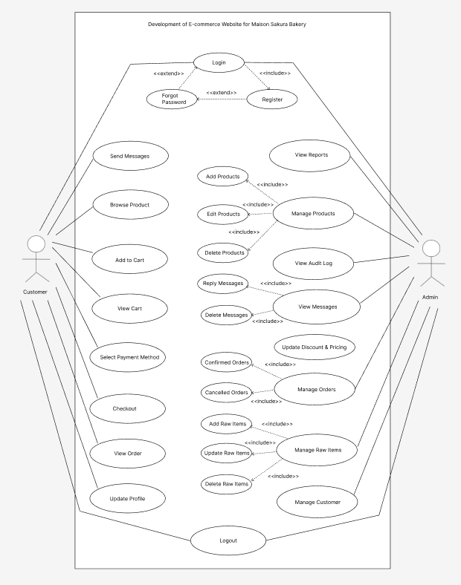
Use Case Diagram

Slide 10
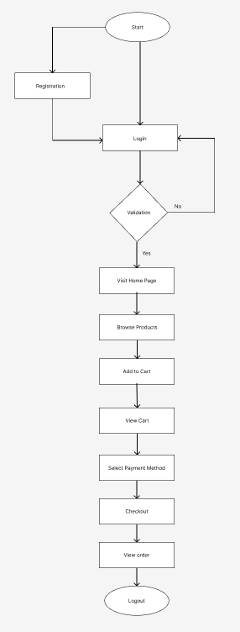
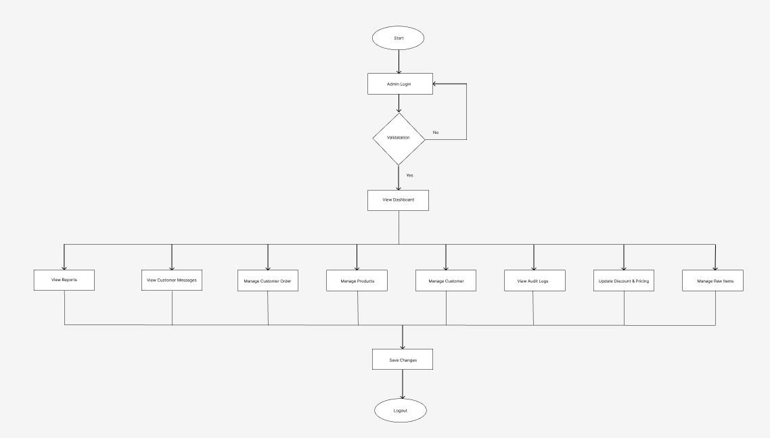
Flowchart for customer & admin

Slide 11
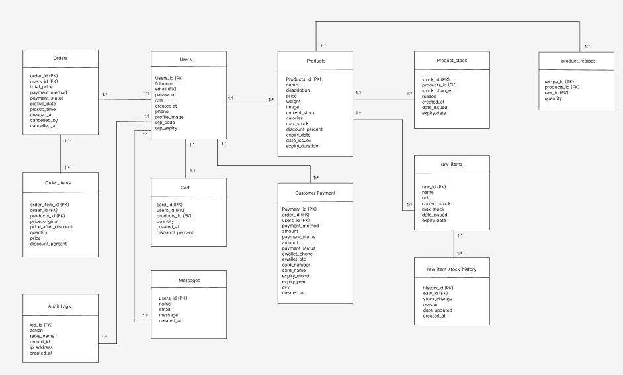
ERD

Slide 12
Customer Module
Visit Home Page
Browse Products
Add to cart, view cart & checkout with payment options
Track order & manage profile
Contact form for inquires
View about page
View terms & conditions and privacy policy page

Slide 13
Admin & Super Admin Module
View dashboard
Manage products, customer orders, raw items, customer
View & reply messages
Manage admin profile
View terms & conditions and privacy policy page
superadmin
Manage admin
View Audit logs & reports

Slide 14
Testing conducted
Unit testing (functional)
Integration testing (functional)
Performance testing - CPU, memory & network (non functional)
Results
Every functional modules passed
Stable performance under load
Low memory usage for static pages
Higher usage for checkout//product page
Positive customer feedback

Slide 15
Discussion
Achievements:
Successful website implementation
Secure transactions and real-time tracking
Improved user experience
Limitations:
No mobile app
Lacks multi-language support
Future Enhancements:
Loyalty & reward system
Real-time order tracking integration
Mobile application development

Slide 16
Reflection
Gained strong technical and analytical skills
Learned full stack web development - HTML, CSS, Javascript, PHP, SQL
Improved problem solving and testing skills
Overcome challenges in debugging and system integration

Slide 17
Conclusion
Project achieved objectives successfully
Developed a fully functional e-commerce website
Improved bakery’s digital presence & operational efficiency
Future work to expand features and mobile reach

Slide 18
Thank You
Have a nice day

